Slide 1

MATALE PETER MOLEPO (PRO 3)
OASIS INFOBYTE

Slide 2
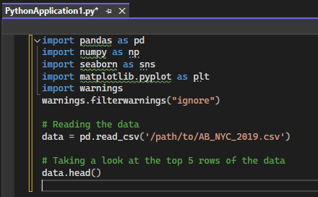
Data Preparation and Cleaning
Step 1: Importing Necessary Libraries and Reading the Data

Slide 3
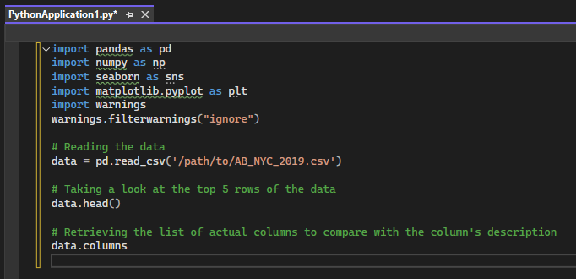
Step 2: Reviewing Data Columns and Comparing Them to the Dataset Description

Slide 4
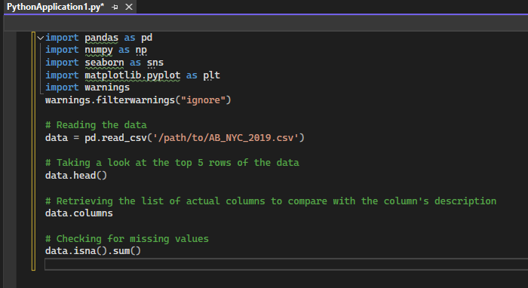
Step 3: Looking for Missing Values

Slide 5
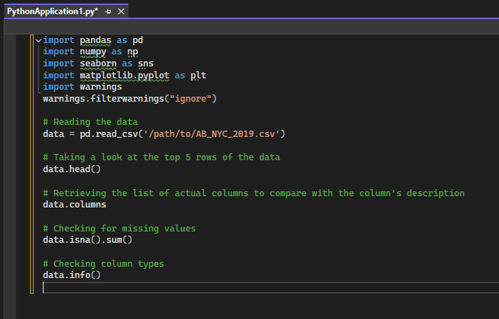
Step 4: Checking Column Types

Slide 6
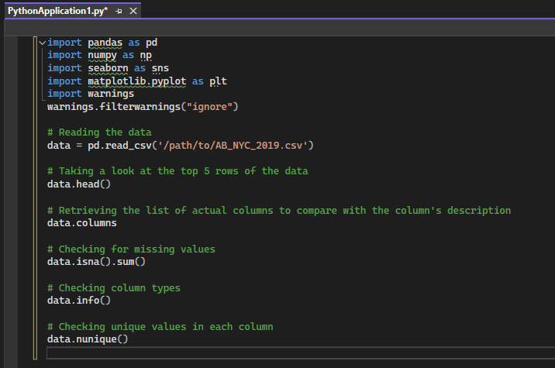
Step 5: Assessing Unique Values

Slide 7
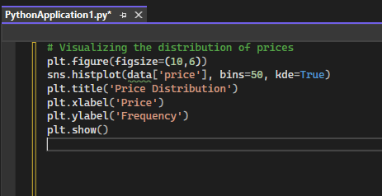
Exploratory Data Analysis (EDA)
Performing EDA to understand the dataset and uncover patterns.
Price Distribution

Slide 8
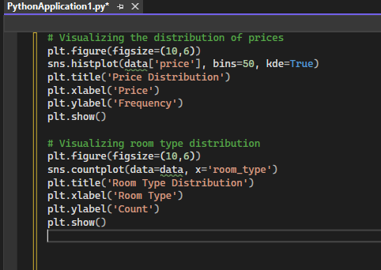
Room Type Distribution

Slide 9
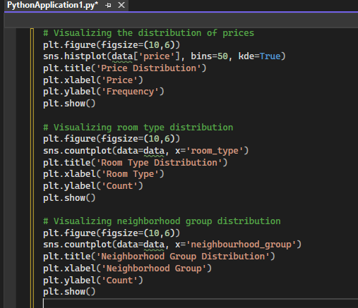
Neighborhood Group Distribution

Slide 10
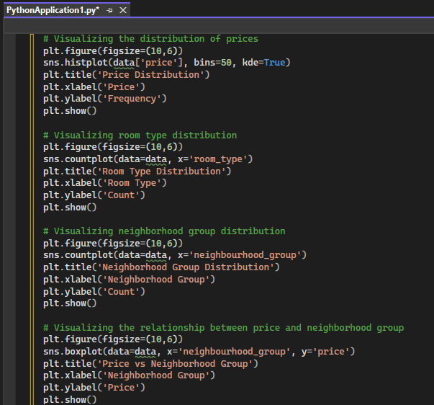
Price vs Neighborhood Group

Slide 11
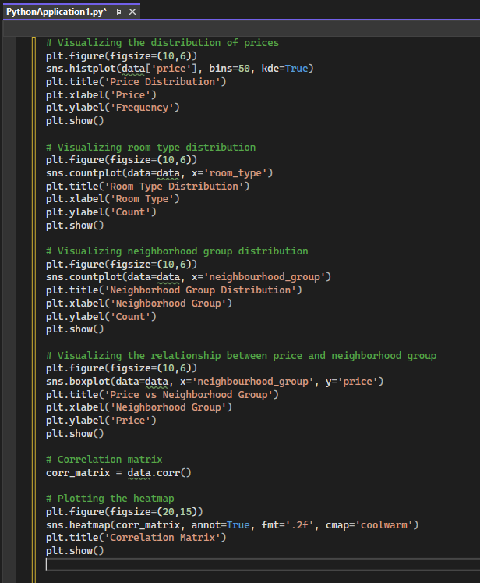
Correlation Analysis
Understanding relationships between variables.

Slide 12
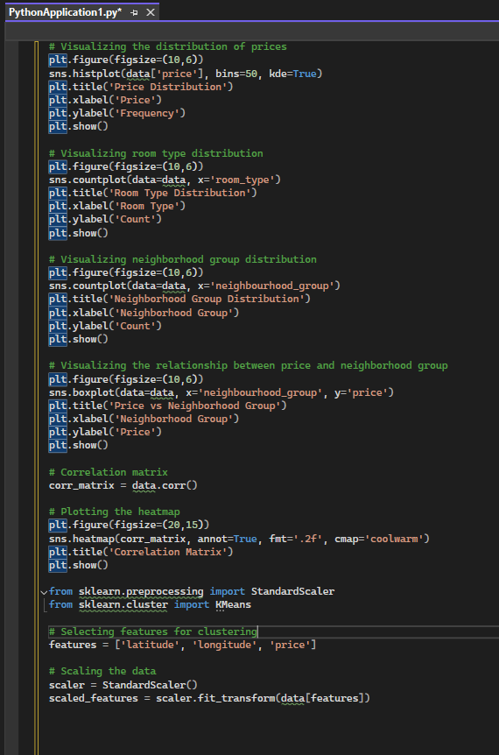
Customer Segmentation Using K-Means Clustering
Applying K-Means clustering to segment customers based on their behavior and demographic information.
Preparing Data for Clustering

Slide 13
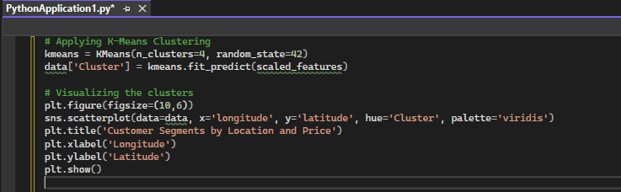
Applying K-Means Clustering

Slide 14
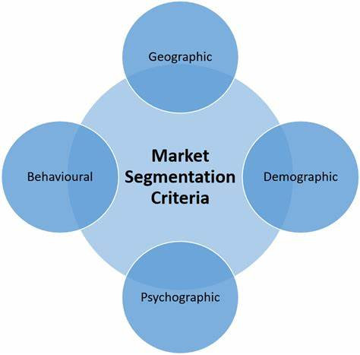
Marketing Segmentation Analysis
Premium Segment:
Targets high prices and prime locations.
Offers premium listings and personalized experiences.
Budget Segment:
Targets lower prices but popular areas.
Offers budget-friendly listings and value deals.
Family Segment:
Promotes family-friendly amenities and local attractions.
Solo Travelers Segment:
• Highlights single-occupancy deals and social events.

Slide 15
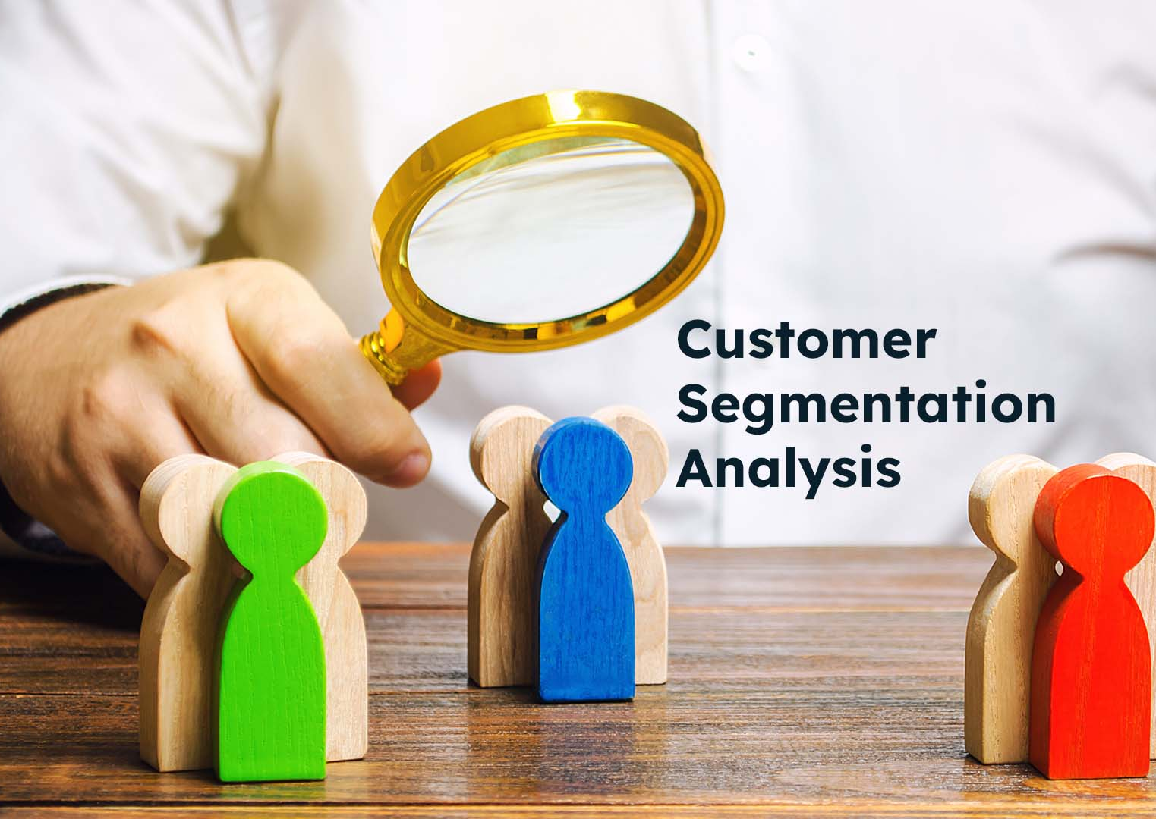
Conclusion
• Identifies distinct customer groups.
• Informs targeted marketing strategies.
• Enhances customer satisfaction.
• Drives business growth.

